Slide 1
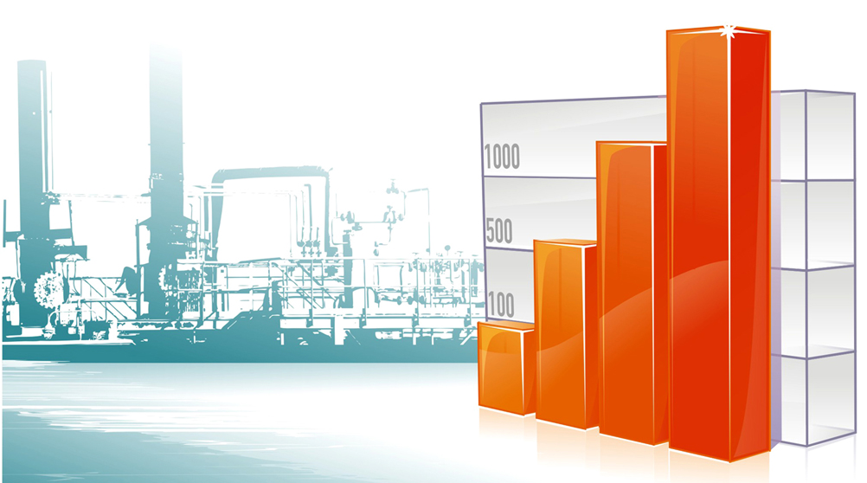
Schedule forecasting
NOAA Data

Slide 2
Obtain data
Go to http://www.ncdc.noaa.gov/.
Then: “Most Popular Data”.
Then: Item #8 “ U.S. Annual Climatological Summary”.
Then: “Individual Station”.
Then: (1) Enter nearest city to the site. (2) Select “Monthly Summaries GHCND. (3) Click the “Search” button.
Then: Select the station with the ‘best’ data – usually the largest airport. Note the available data dates. Click on “Add to cart”.
In the “View/Edit Your Cart” supply the “output date range” – usually 01Jan to 31Dec of the available full years. Select CSV for output format. Click “continue”.
Expand the “Computed” checkbox and select DP01. Click “Continue”. Add your email address and then “Submit Order”. Your data should arrive shortly.

Slide 3
Process Data
Your file will be listed on the green bar near the top of the email.
Open the csv file – see RawData.jpg
Add two columns – one for year and one for month. Use the ‘left’ and ‘mid’ functions to populate the columns – see ModData.jpg.
Insert a pivot table – see Pivot.jpg
Determine the mean and standard deviations for the months. Use a ‘Z’ value of 1.28 to determine the P10 and P90 values – see Table.jpg
Round the mean, P10, and P90 to get your ‘min’, ‘lik’, and ‘max’ values – see Table.jpg.

Slide 4
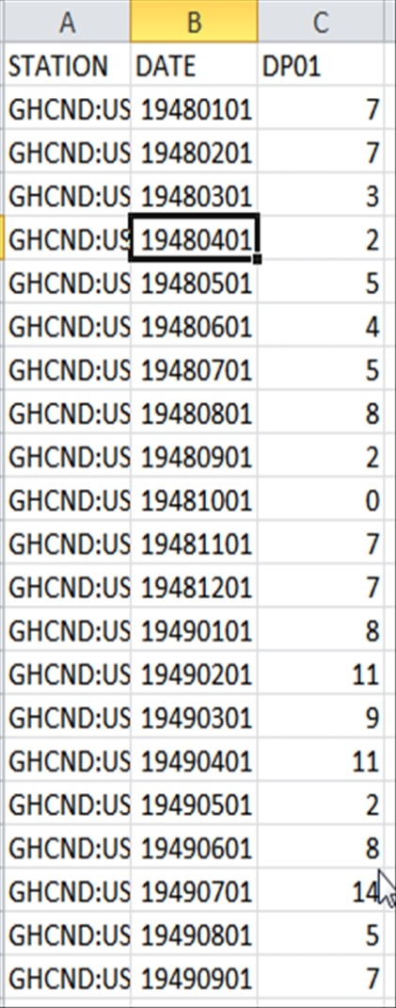
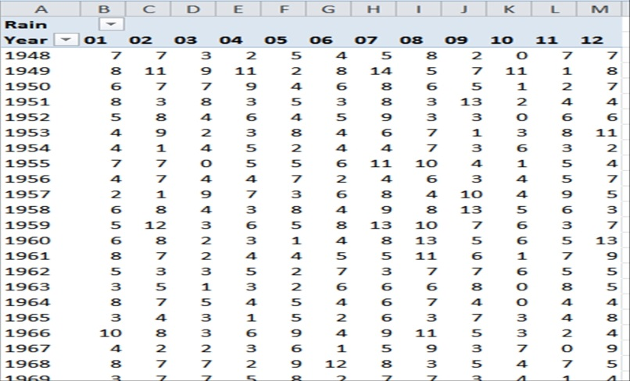
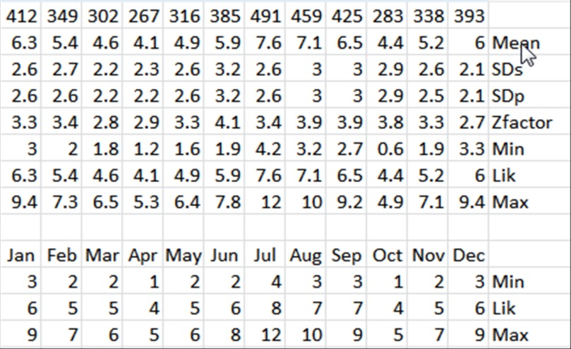
Charts – days of rain
Pivot.jpg
RawData.jpg
ModData.jpg
Table.jpg

Slide 5
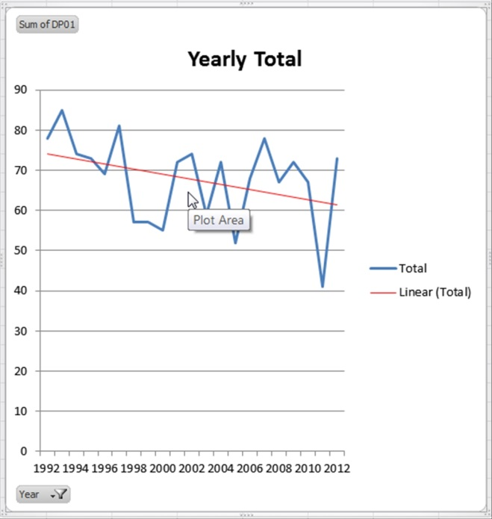
Analyze Data
65 Year Totals & Trend line
20 Year Totals & Trend line
Since slope of the trend line for the last 21 years is decidedly different than the trend line for the 65 year range, it is recommended that you re-run the process on the last 21 years (1992-2012) and compare the differences. It is not recommended that you use less than 20 years of data in developing your ‘Table’.

Slide 6
Analysis continued
As you will note, there is some slight variance between the two ranges. Which to use is up to the planner. Personally, I would use the 21 year range, but either would return values within the level of accuracy of the analysis.

Slide 7
Conclusion
The analysis of the data is sufficiently ‘normal’ to justify use of the Z table value and standard deviations in determining P10 and P90 values. We are ‘reasonably’ confident in the values derived.

Slide 8
Suggestions - caveats
Define a rain day. No standard definition exists. Here we used 0.1” or greater of daily rainfall as our definition (DP01).
Analyze your data. You may not always have ‘acceptable’ data and should inform users if so.
This procedure is to be used with some other probabilistic analysis. I suggest Primavera Risk Analyzer “Weather Module”. Using a Weather Allowance activity that can be ‘risked’, in lieu of a more rigorous analysis should only be used as a ‘last’ resort – better than nothing, but a poor substitute.
Define mitigating circumstances – make-up days, non-work days (Saturdays, Sundays, Holidays) that might reduce the impact of a rain day.
Should another metric be needed - say snowfall, temperature, wind speed, or a greater rainfall amount - this method should hold, though processing the data may be significantly more onerous.

